Slide 1
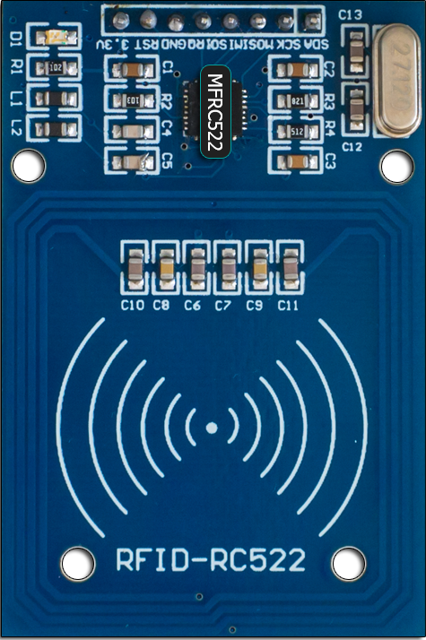






1
2
3
IoT Hub
Event Hub
RFiD Reader
4
Stream Analytics
5
6
PowerBI Reports
SQL Azure Database
Azure Function

